Slide 1


Isolating transdiagnostic effects reveals specific genetic profiles in psychiatric disorders
Engin Keser¹, Wangjingyi Liao¹, Andrea G. Allegrini, Thalia C. Eley, Kaili Rimfeld,
Robert Plomin² and Margherita Malanchini²
Pre-print:
¹ These authors contributed equally
² These authors jointly supervised the work
engin.keser@kcl.ac.uk

Slide 2
General factor of psychopathology, p
Evidence for a great degree of genetic overlap between psychiatric diagnoses
Notes:
Genetic and genomic research showed that there is a great degree of genetic overlap across psychiatric diagnoses.

Slide 3
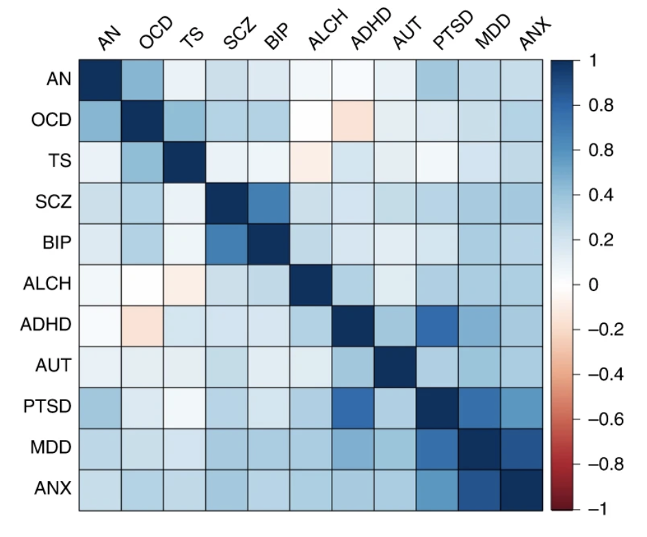
General factor of psychopathology, p
Evidence for a great degree of genetic overlap between psychiatric diagnoses
rg between
MDD & ANX = 0.87
PTSD & ADHD = 0.78
MDD & PTSD = 0.75
SCZ & BIP = 0.68
Grotzinger et al. (2022)
Notes:
These are the results from a recent multivariate GWAS analysis of 11 major psychiatric disorders conducted by Grotzinger et al. As you can see, overall, there is positive genetic correlation between most of the psychiatric disorders.

Slide 4
General factor of psychopathology, p
p-factor reflects a general liability to psychopathology (Lahey et al., 2012; Caspi et al., 2014)
Notes:
This positive genetic correlations between psychiatric disorders is consistent with the idea of general factor of psychopathology, called p-factor. The p-factor represents an individual’s liability to develop all sorts of mental health problems.

Slide 5
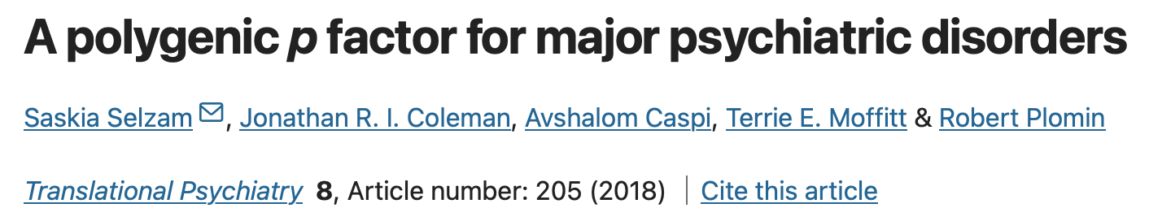
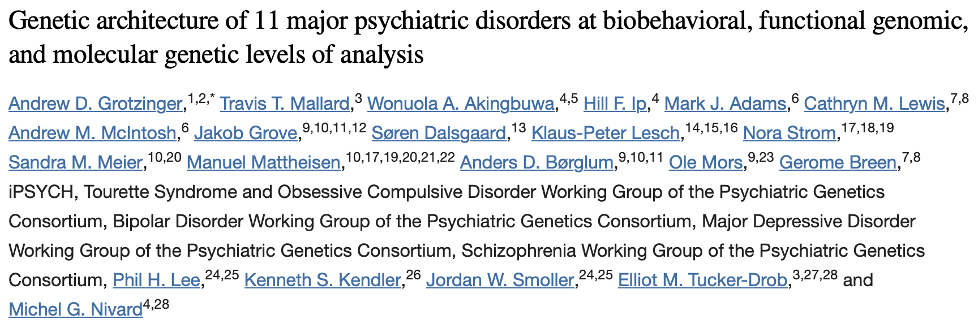
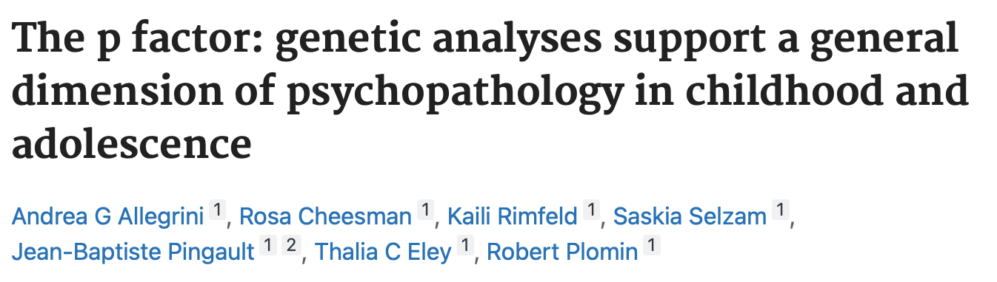
p-factor has emerged from recent genetic and genomic studies
Notes:
More recent genetic and genomic studies also showed that the p-factor could also be observed at the genetic level…and here are a few examples of these studies..

Slide 6
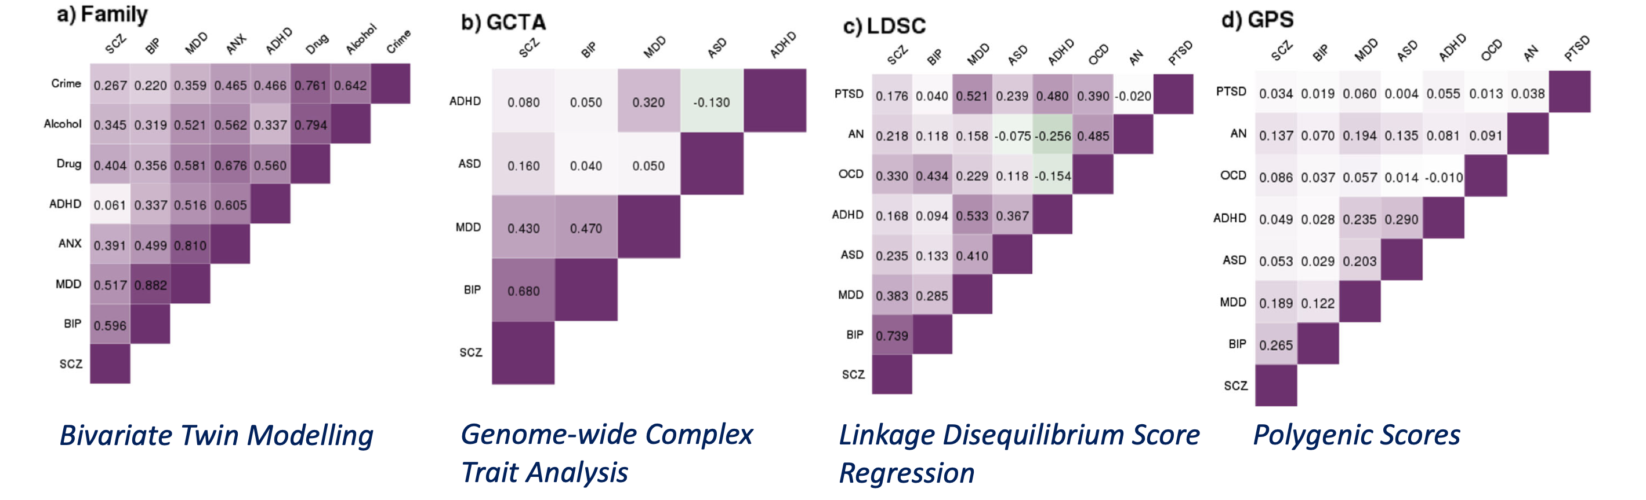
Evidence for genetically driven p
Genetic correlations between psychiatric disorders & variance explained by the first principal component
Selzam et al. (2018)
Notes:
For example, in a study Selzam et al compared genetic correlations between psychiatric traits using different methods and examined their support for a genetic p factor, using principal component analysis.

Slide 7
Evidence for genetically driven p
Genetic correlations between psychiatric disorders & variance explained by the first principal component
p-factor explains 20-60% of the genetic variance
Selzam et al. (2018)
Notes:
Across all methods they used, they found that p explained 20-60% of the total genetic variance.

Slide 8
Why control for p?
Given this widespread genetic overlap between psychiatric disorders that is partly captured by p, controlling for p might help us to uncover disorder-specific genetic effects.
Notes:
So, given this widespread genetic overlap between psychiatric disorders that is partly captured by p, we thought that controlling for p might help us uncover more disorder-specific genetic effects.

Slide 9
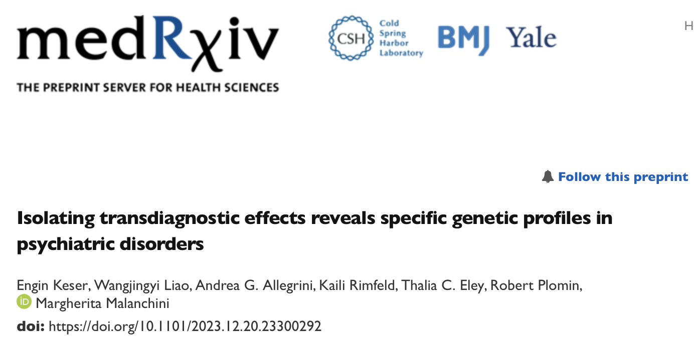
Aim of the study
Investigating genetic effects associated with individual psychiatric disorders that are independent of ‘p’
Control for the effect of ‘p’ in order to capture more disorder-targeted genetic risk, ‘non-p’
Notes:
This brings us to the aim of the current..which was to …….
We did this by using genomic structural equation modelling, which allowed us to control for the effect of ‘p’ in order to capture more disorder-targeted genetic risk, which we called non-p here.
This is the prep-print of our paper, which is currently under review, if you’d like to take a look at it.

Slide 10
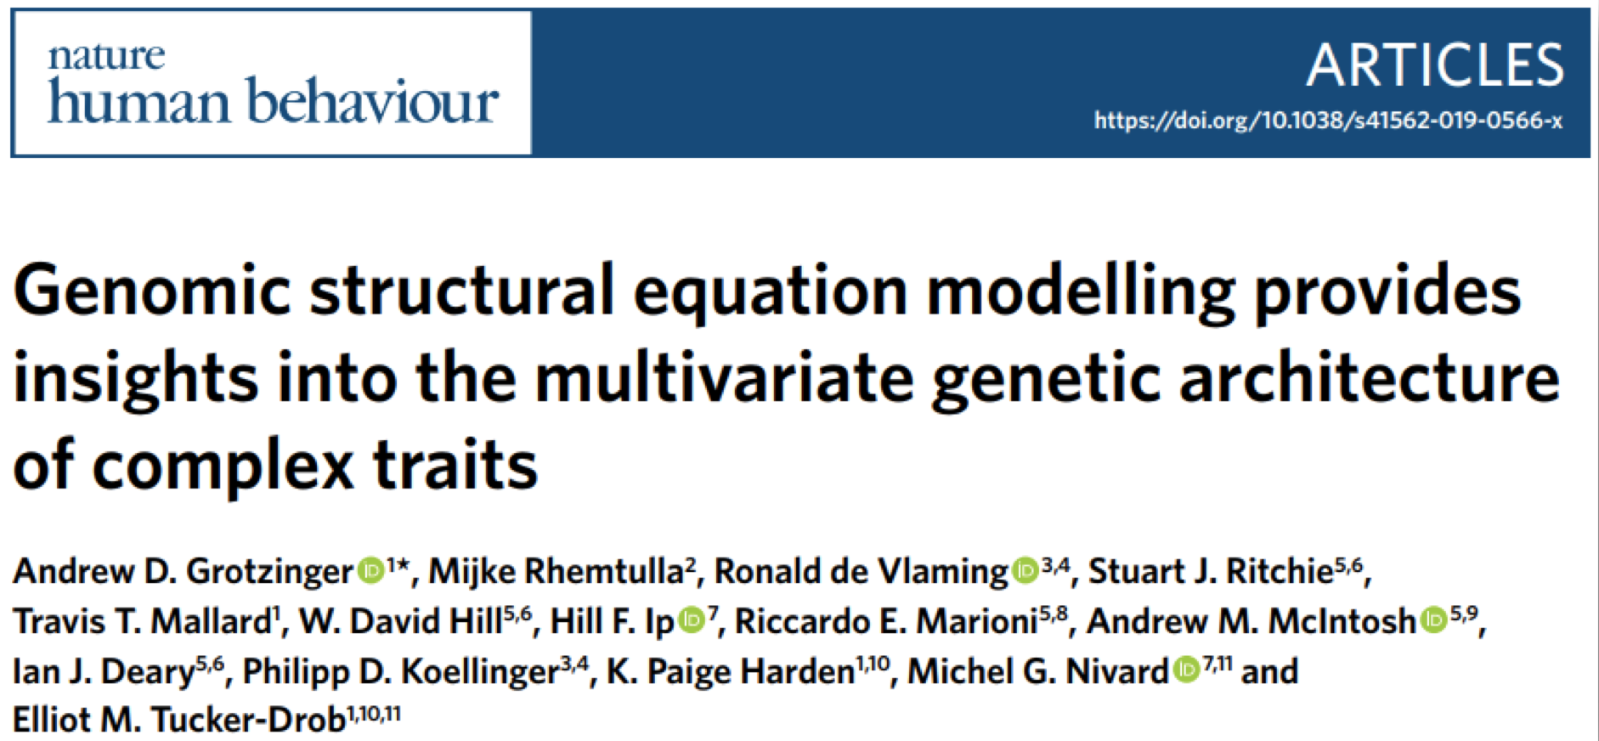
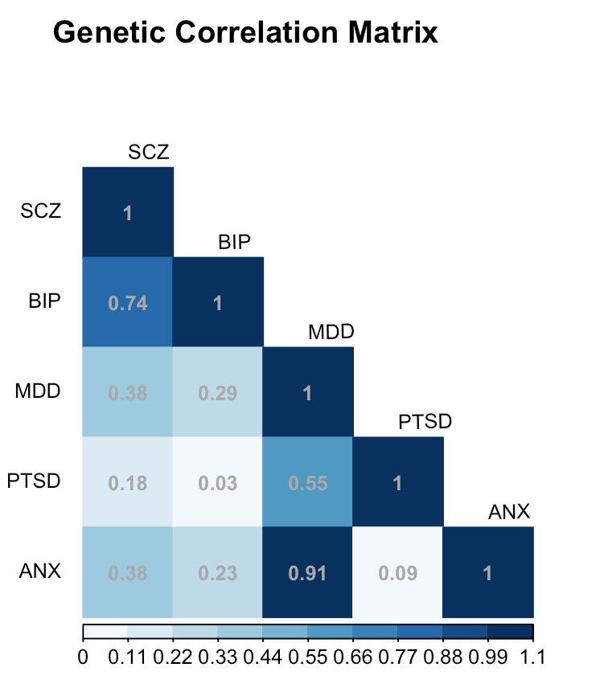
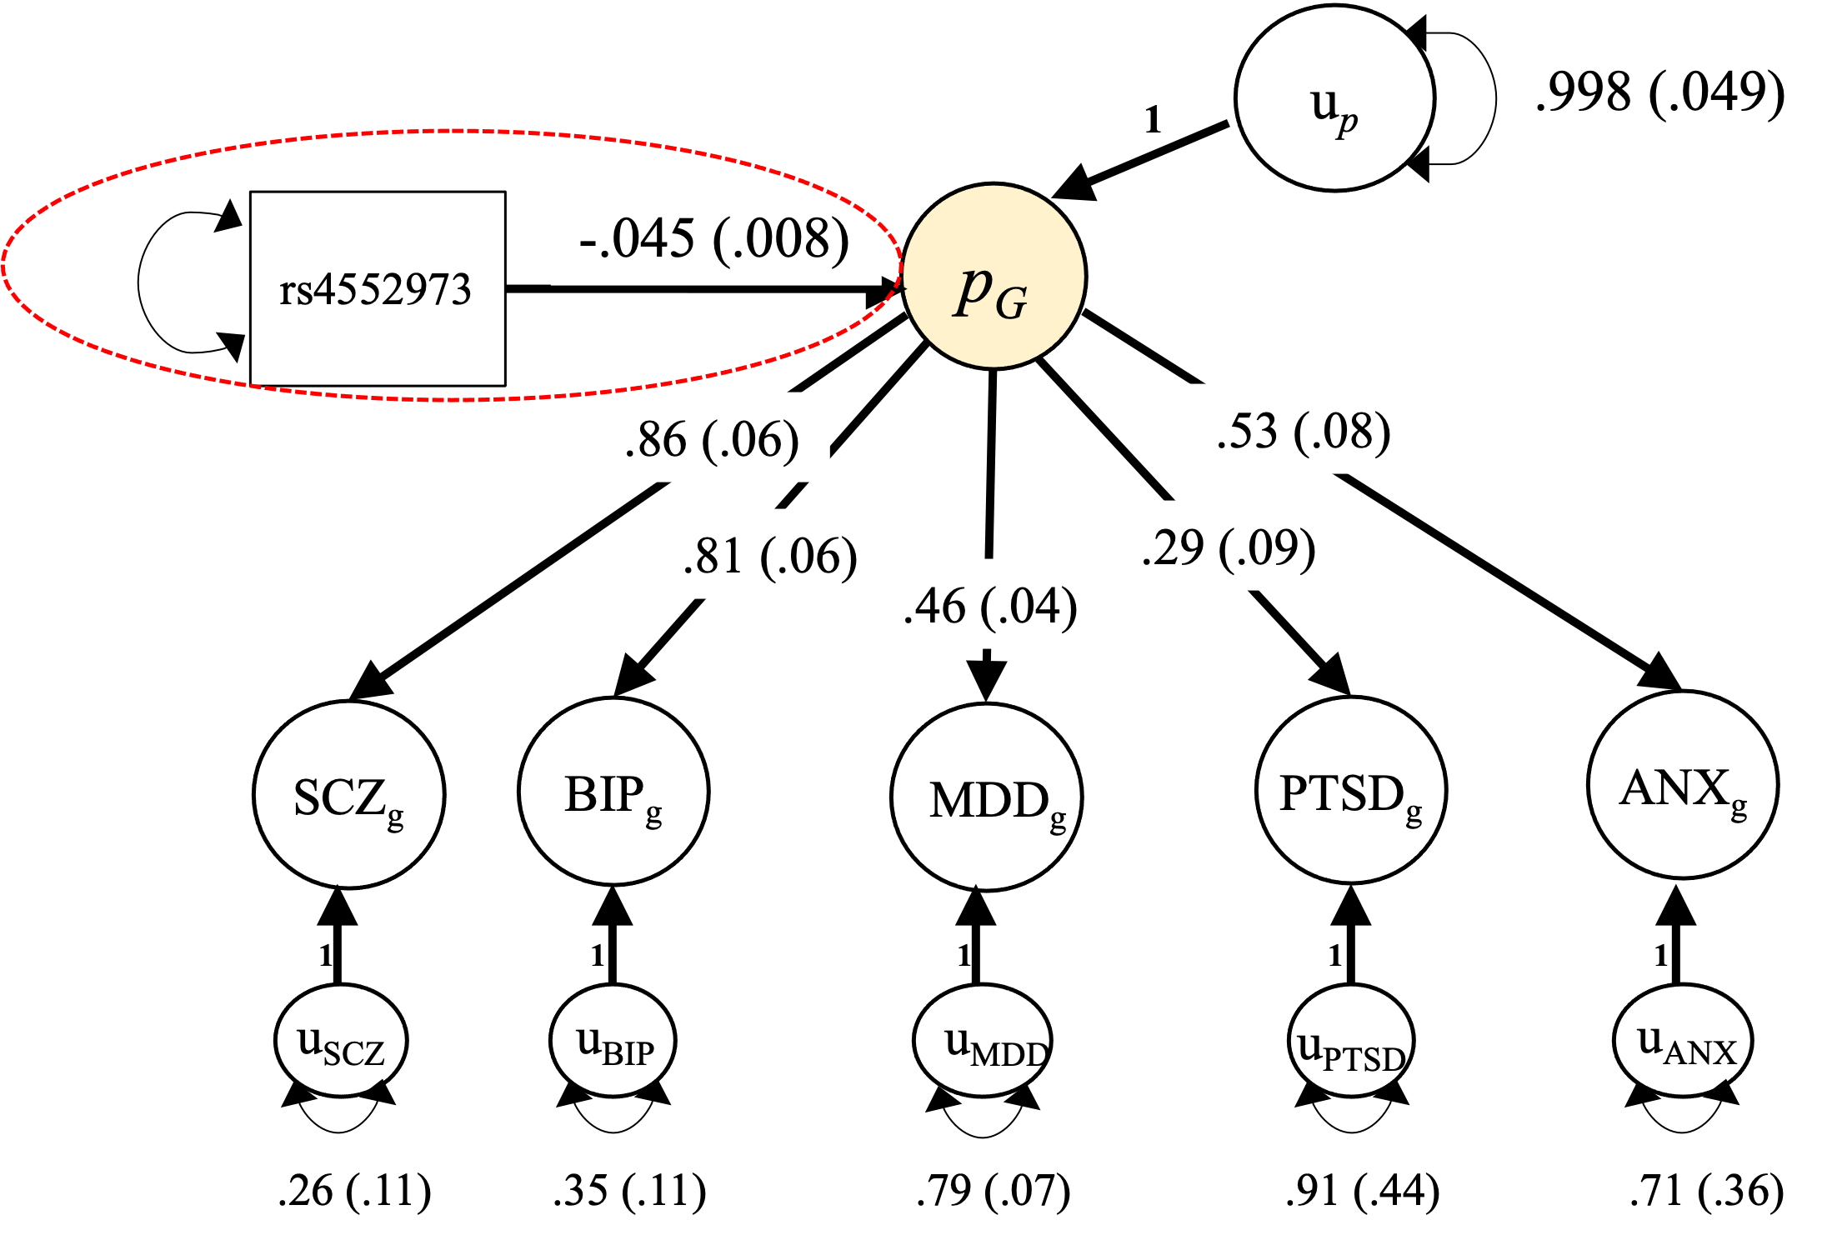
Genomic structural equation modelling
Stage 1: Estimate a genetic covariance matrix and its
associated sampling covariance matrix
Uses linkage disequilibrium (LD) score regression
Stage 2: Fit a Structural Equation Model
to the matrices from Stage 1
Notes:
Very briefly, Genomic SEM is a framework for modelling patterns of genetic correlations across different traits using GWAS summary statistics.

Slide 11
Common factor model
p
p
1
.85(.04)
.82(.03)
.78(.04)
.62(.03)
.53(.02)
.52(.03)
.45(.04)
.43(.04)
.36(.05)
.33(.03)
.24(.04)
ANX
MDD
PTSD
BIP
SCZ
ADHD
ASD
ALCH
OCD
AN
TS
1
1
1
1
1
1
1
1
1
1
1
U_{ANX}
U_{MDD}
U_{PTSD}
U_{BIP}
U_{SCZ}
U_{ADHD}
U_{ASD}
U_{ALCH}
U_{OCD}
U_{AN}
U_{TS}
.27(.07)
.32(.04)
.38(.17)
.61(.04)
.72(.03)
.73(.04)
.80(.09)
.82(.10)
.87(.16)
.89(.06)
..94(.11)
Notes:
Here we used Genomic SEM in order to capture the shared genetic effects across these 11 major psychiatric disorders and then to isolate genetic variance in each disorder beyond what is captured by the p-factor.
So, we fitted a common factor model to the genetic covariance matrix. In this model, all the disorders load directly on to this single factor, p-factor.

Slide 12
Residual genetic variance, non-p
p
p
1
SNP
.85(.04)
.82(.03)
.78(.04)
.62(.03)
.53(.02)
.52(.03)
.45(.04)
.43(.04)
.36(.05)
.33(.03)
.24(.04)
ANX
MDD
PTSD
BIP
SCZ
ADHD
ASD
ALCH
OCD
AN
TS
1
1
1
1
1
1
1
1
1
1
1
U_{ANX}
U_{MDD}
U_{PTSD}
U_{BIP}
U_{SCZ}
U_{ADHD}
U_{ASD}
U_{ALCH}
U_{OCD}
U_{AN}
U_{TS}
.27(.07)
.32(.04)
.38(.17)
.61(.04)
.72(.03)
.73(.04)
.80(.09)
.82(.10)
.87(.16)
.89(.06)
..94(.11)
Non-p ANX
Notes:
The same model also allowed us to capture the residual genetic variance that was associated with each disorder independent of the shared effects.
AND We simultaneously run a GWAS on p and the residual variance in each disorder.
This is a diagram of the GWAS that we ran to capture genetic variance in ANX after accounting for the shared effects.
We repeated the same process 11 times, separately for each disorder.
This allowed us to Estimate the SNP effect on the residual of the disorder after removing common variation.

Slide 13
Results
Genetic correlations between the disorders before & after residualizing for p
Genetic correlations between each of the 11 disorders- uncorrected and corrected for p- and biobehavioural traits
Notes:
So, our analyses resulted in 11 non-p summary statistics, which we then used in LD score regression
to investigate the changes in genetic correlations between the disorders before and after partialling out genetic effects associated with the p-factor. And we also looked at the genetic correlations between each of the 11 disorders-uncorrected and corrected for p- and behavioural traits.

Slide 14
Results
Genetic correlations between the disorders before & after residualizing for p
Notes:
First, I am going to go through the results for the genetic correlations between the disorders.

Slide 15
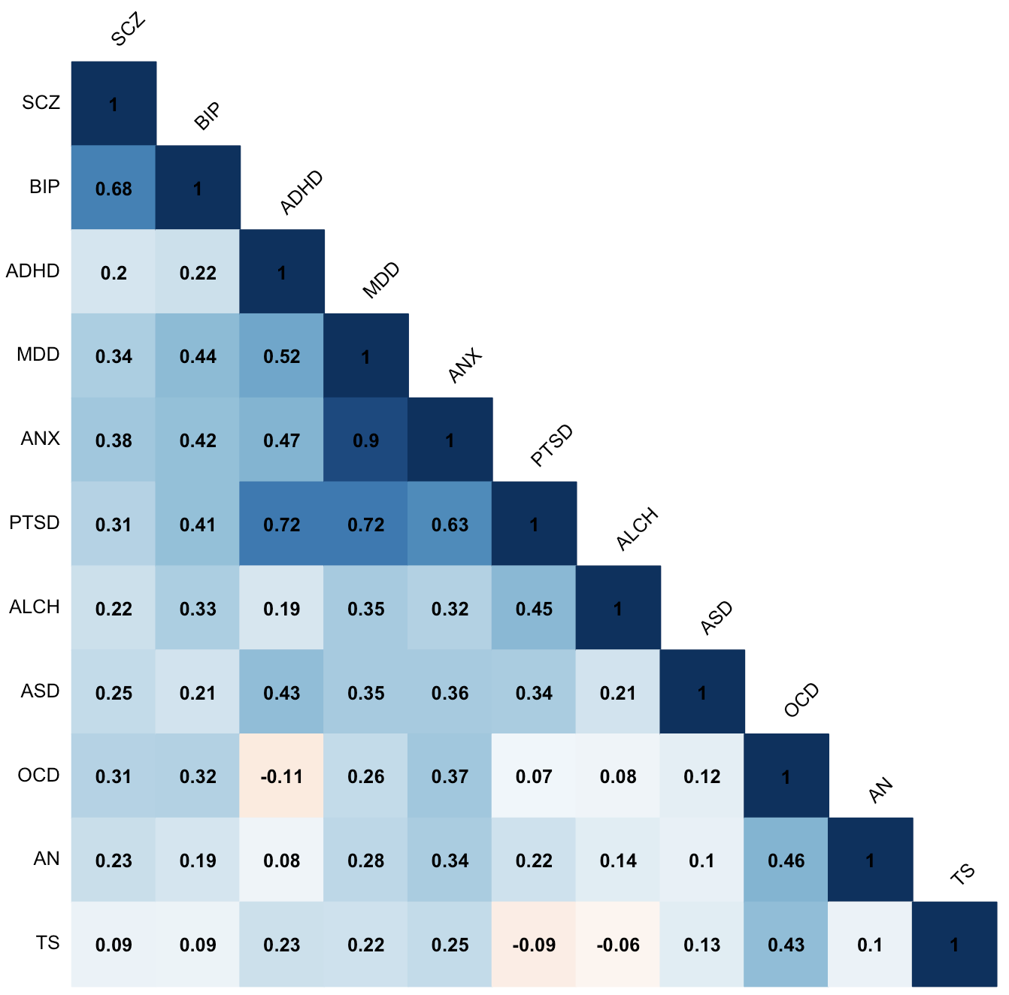
Removing transdiagnostic genetic effects significantly changed genetic relationships between psychiatric disorders.
Notes:
First, our results showed that removing …..
This is a heatmap of genetic correlations between the disorders before residualizing for p- for uncorrected disorders.
Our results were consistent with what’s reported in the literature. Overall, there was positive genetic correlations between most disorders.

Slide 16
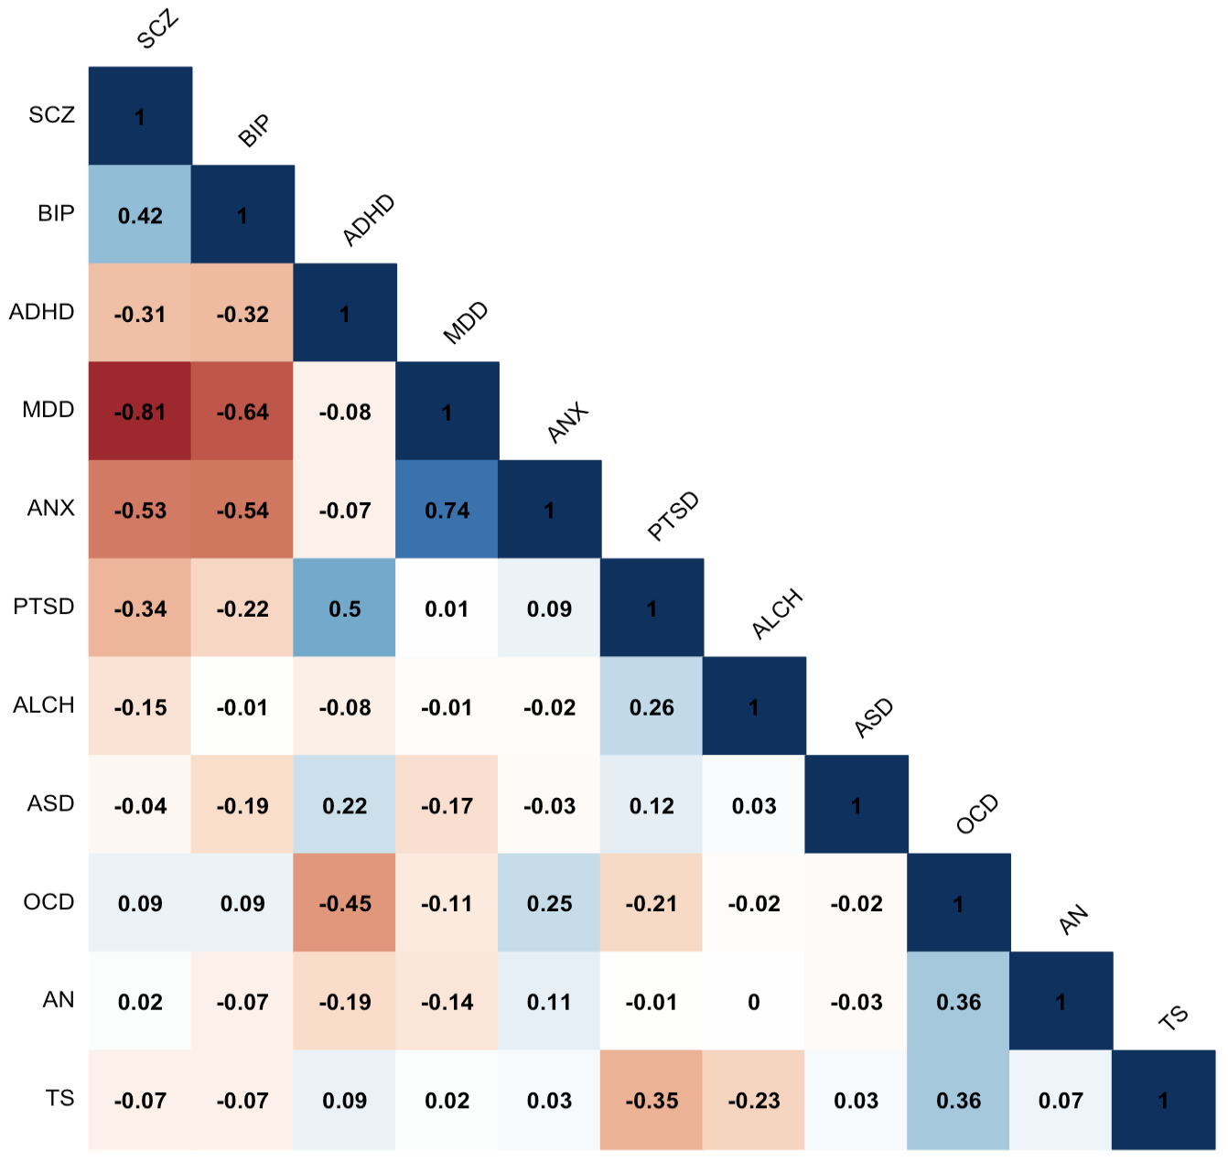
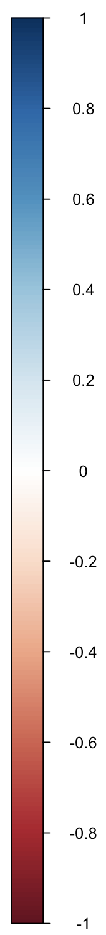
Removing transdiagnostic genetic effects significantly changed genetic relationships between psychiatric disorders.
Notes:
And then here, you see the genetic correlations after partialling out p, so for the non-p disorders.
And as you can see here, partialling out p significantly changed the genetic correlations between the disorders.
This is a busy slide but I am going go through some results now.

Slide 17
Removing transdiagnostic genetic effects significantly changed genetic relationships between psychiatric disorders.
BIP & SCZ
.68 > .42
ANX & MDD
.90 > .74
Notes:
So, overall there were different patterns of change.
Some of the disorders showed some reduction in genetic correlations such as BIP & SCZ and ANX&MDD

Slide 18
Removing transdiagnostic genetic effects significantly changed genetic relationships between psychiatric disorders.
BIP & SCZ
.68 > .42
ANX & MDD
.90 > .74
ADHD & MDD
.52 > -0.08
PSTD & ANX
.63 > 0.09
Notes:
and sometimes this reduction was much larger for ex,, PTSD &MDD
These results suggest that,the substantial genetic correlation between BIP&SCZ, and ANX and MDD are largely independent of p. In contrast, for ADHD and MDD or for PTSD and ANX, the genetic relationship between them seems to be completely mediated by p. As when we took out p, there wasn’t any genetic overlap.

Slide 19
Removing transdiagnostic genetic effects significantly changed genetic relationships between psychiatric disorders.
OCD & ADHD
-0.11 > -0.45
Notes:
We also observed increase in genetic correlations. For ex, OCD and ADHD
The correlations between them was small and negative, but after removing p, the correlation between them increased significantly
This finding is actually in line with the current clinical perspective because ADHD and OCD are thought to be at the opposite extremes of the impulsivity-compulsivity continuum.

Slide 20
Removing transdiagnostic genetic effects significantly changed genetic relationships between psychiatric disorders.
ADHD & BIP
0.22 > -0.32
MDD & SCZ
0.34 > -0.81
ANX & BIP
0.42 > -0.54
Notes:
One of the most interesting patterns of change was WHERE THE GENETIC CORRELATION BETWEEN PAIRS OF DISORDERS GOES FROM POSITIVE TO NEGATIVE.
For ex, MDD and SCZ
So, these disorders became inversely correlated after taking out p, which might indicate that genetic variants operate in opposite directions in the development of these two disorders. And the original positive correlation between them was due to the contribution of p.

Slide 21
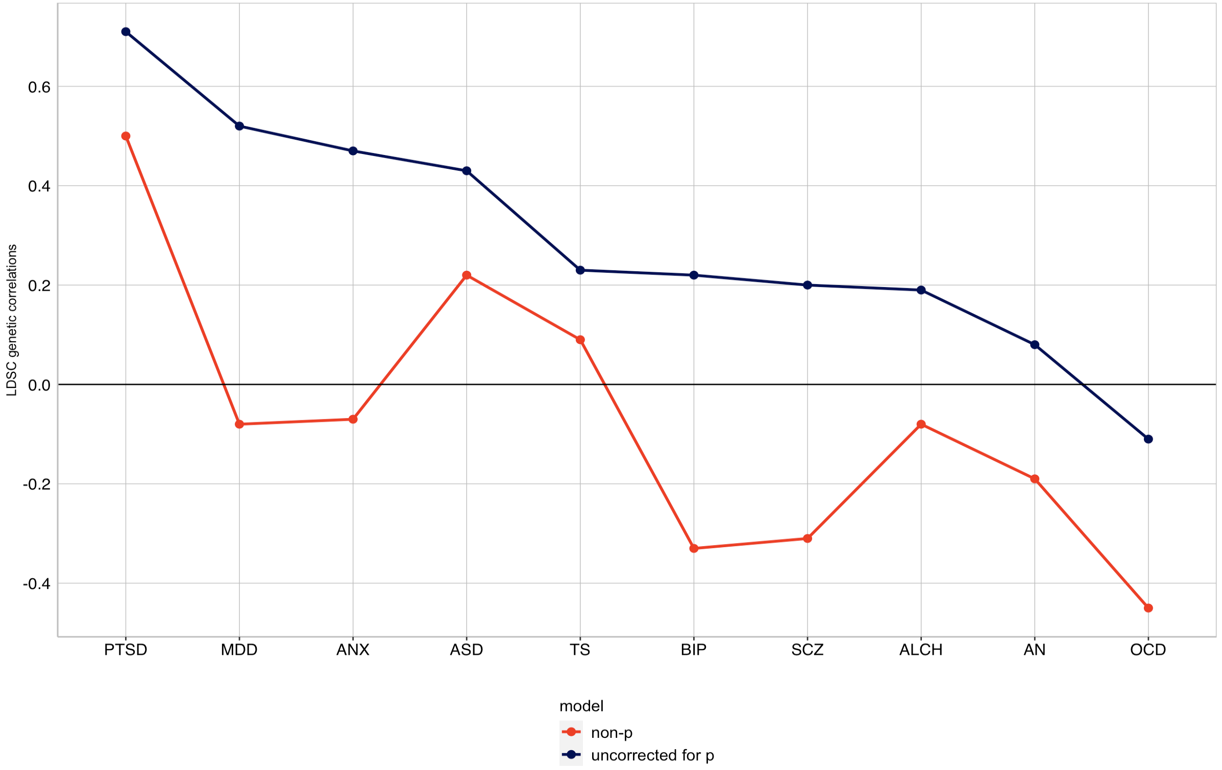
ADHD as an example
Notes:
This is just a different way of showing the same results, using ADHD as an example here. /// This figure shows the genetic correlations between ADHD and the other 10 disorders. The blue line represents the genetic correlations before residualizing for p, and the red line is genetic correlations for the non-p disorders.
The major finding here is that the changes in genetic correlations are not uniform (so the blue and the red lines are not parallel)

Slide 22
ADHD as an example
rg between ADHD and PSTD
0.72 > 0.5
rg between ADHD and MDD
0.52 > -0.08
Notes:
For example, if we look at the genetic correlations between ADHD with PTSD and MDD. Uncorrected for p, the genetic correlation between ADHD and PTSD is very high, 0.72. When they are corrected for p, the genetic correlation declines to 0.5, a nonsignificant difference. Thus, the substantial genetic correlation between ADHD and PTSD is largely independent of p.
In contrast, for ADHD & MDD, the genetic correlation dropped from 0.52 to -0.08. So, genetic overlap btw them disappeared when they are corrected for p. This suggests that the genetic relationship between ADHD and MDD is completely mediated by p.
AND THE IMPORTANT POINT HERE IS THAT THESE differences in reduction in genetic correlations are not simply due to the disorders’ genetic correlations with p, because both PTSD (0.78) and MDD (0.82) loads high on p. HOWEVER, the reduction with P corrected GENETIC CORRELATION WITH ADHD IS MUCH REDUCED FOR MDD BUT NOT FOR PTSD

Slide 23
Results
Genetic correlations between each of the 11 disorders- uncorrected and corrected for p- and biobehavioural traits
Socio-demographic
Anthropometric
Health-related
Psychological
Notes:
So, these were the results for genetic correlations between the disorders.
Next, we looked at the genetic correlations between the disorders –both uncorrected and corrected for p- and external traits.
In terms of external traits, we focused on four broad categories of traits: socio-demographic, anthropometric, health-related, and psychological traits. So, there are a lot of results but today I will show you some of the interesting ones…

Slide 24
Removing transdiagnostic genetic effects from psychiatric disorders resulted in divergent patterns of genetic associations with biobehavioural traits.
Notes:
Overall, our results showed that removing shared genetic effects ….

Slide 25
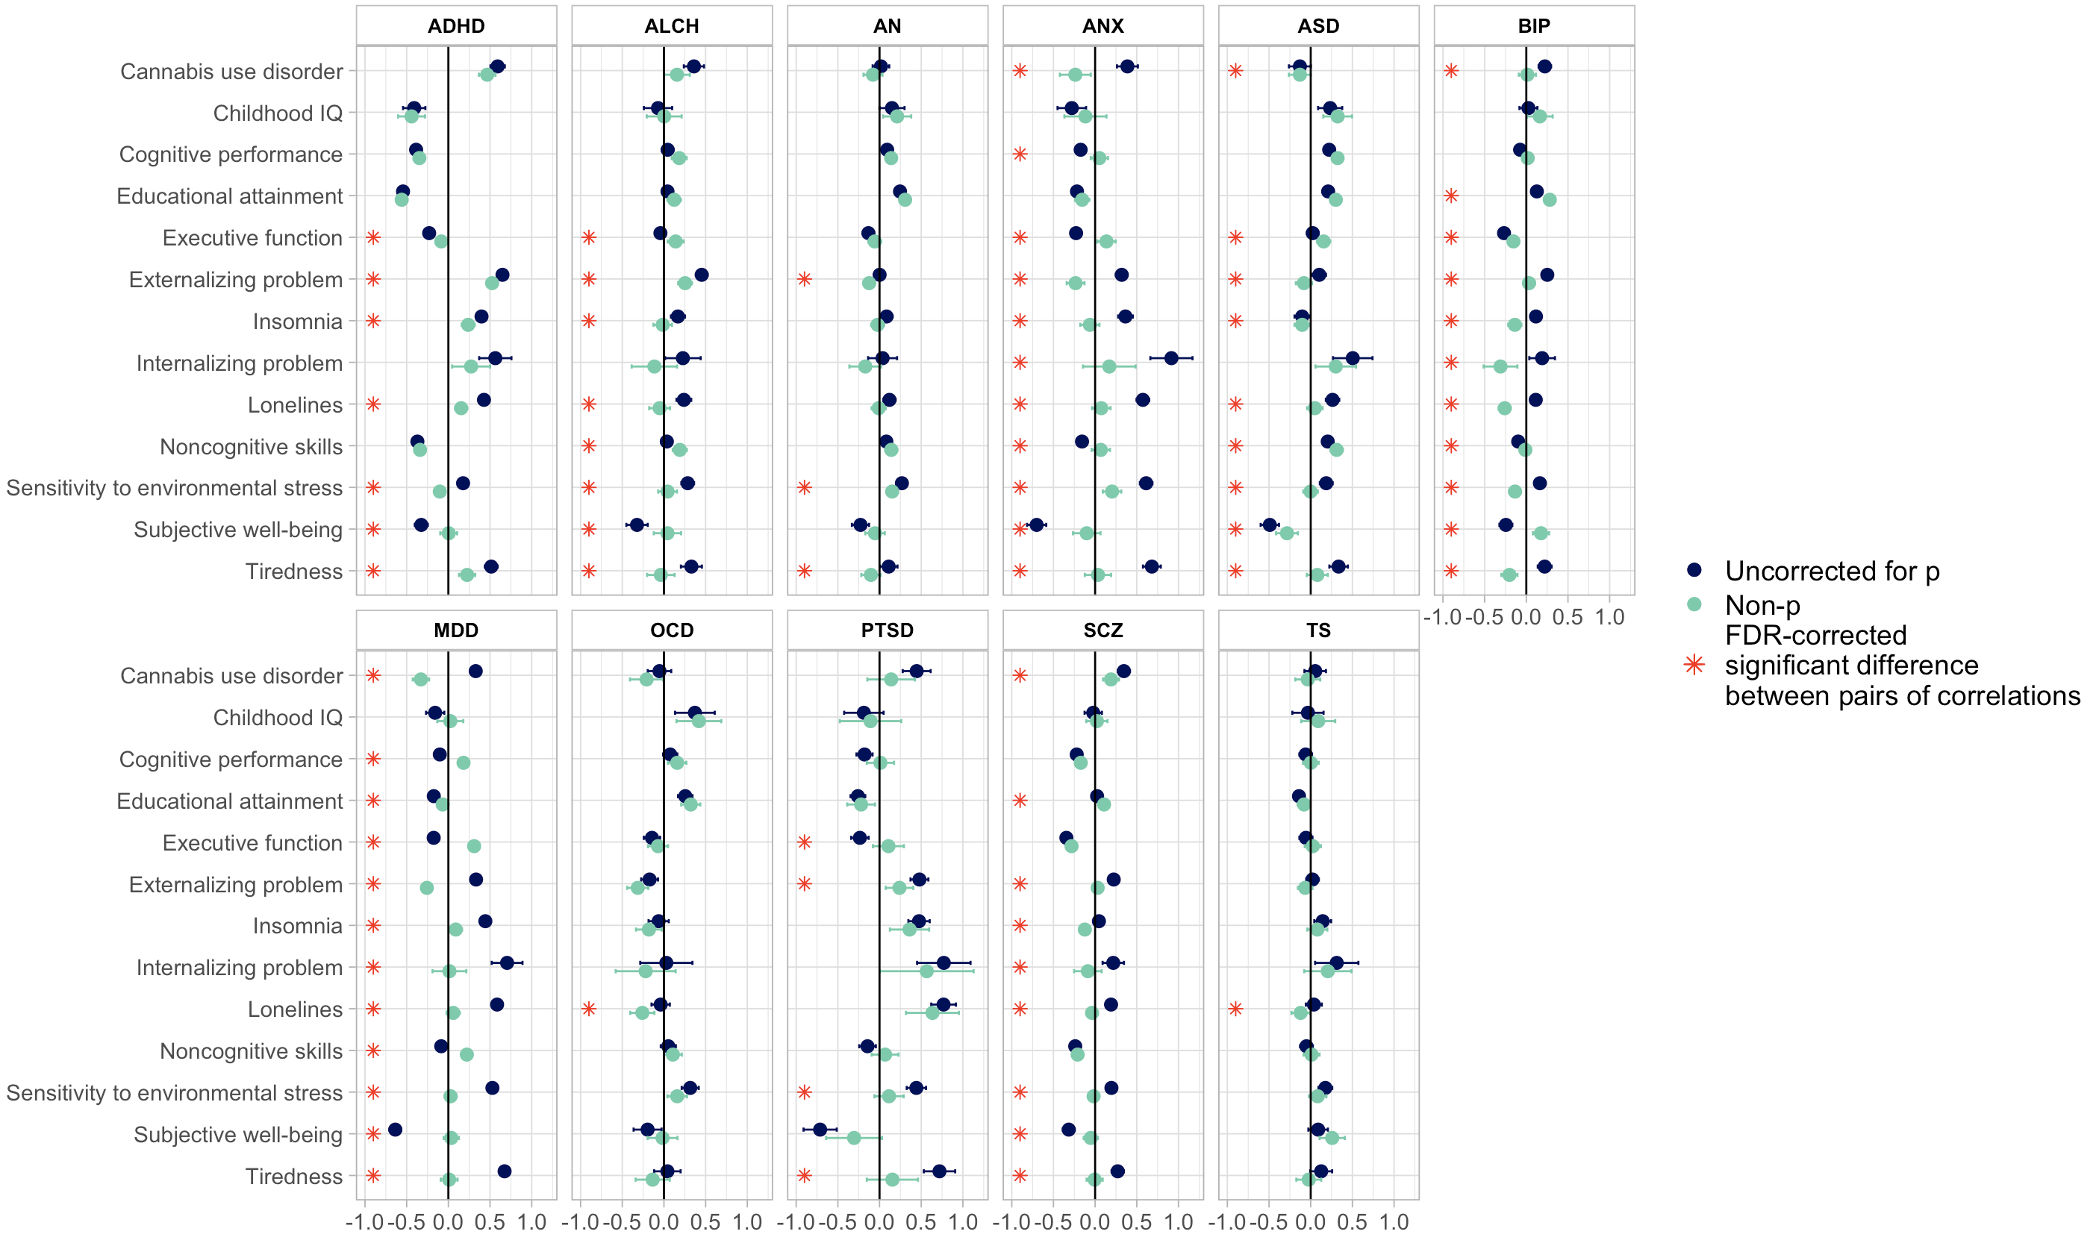
Removing transdiagnostic genetic effects from psychiatric disorders resulted in divergent patterns of genetic associations with biobehavioural traits.
Psychological traits
Notes:
This figure shows the genetic correlations btw the disorders and psychological traits.
In most of the cases, the genetic correlations were lower for the non-p disorders than for the uncorrected disorders, and these differences were significant, as you can see here.

Slide 26
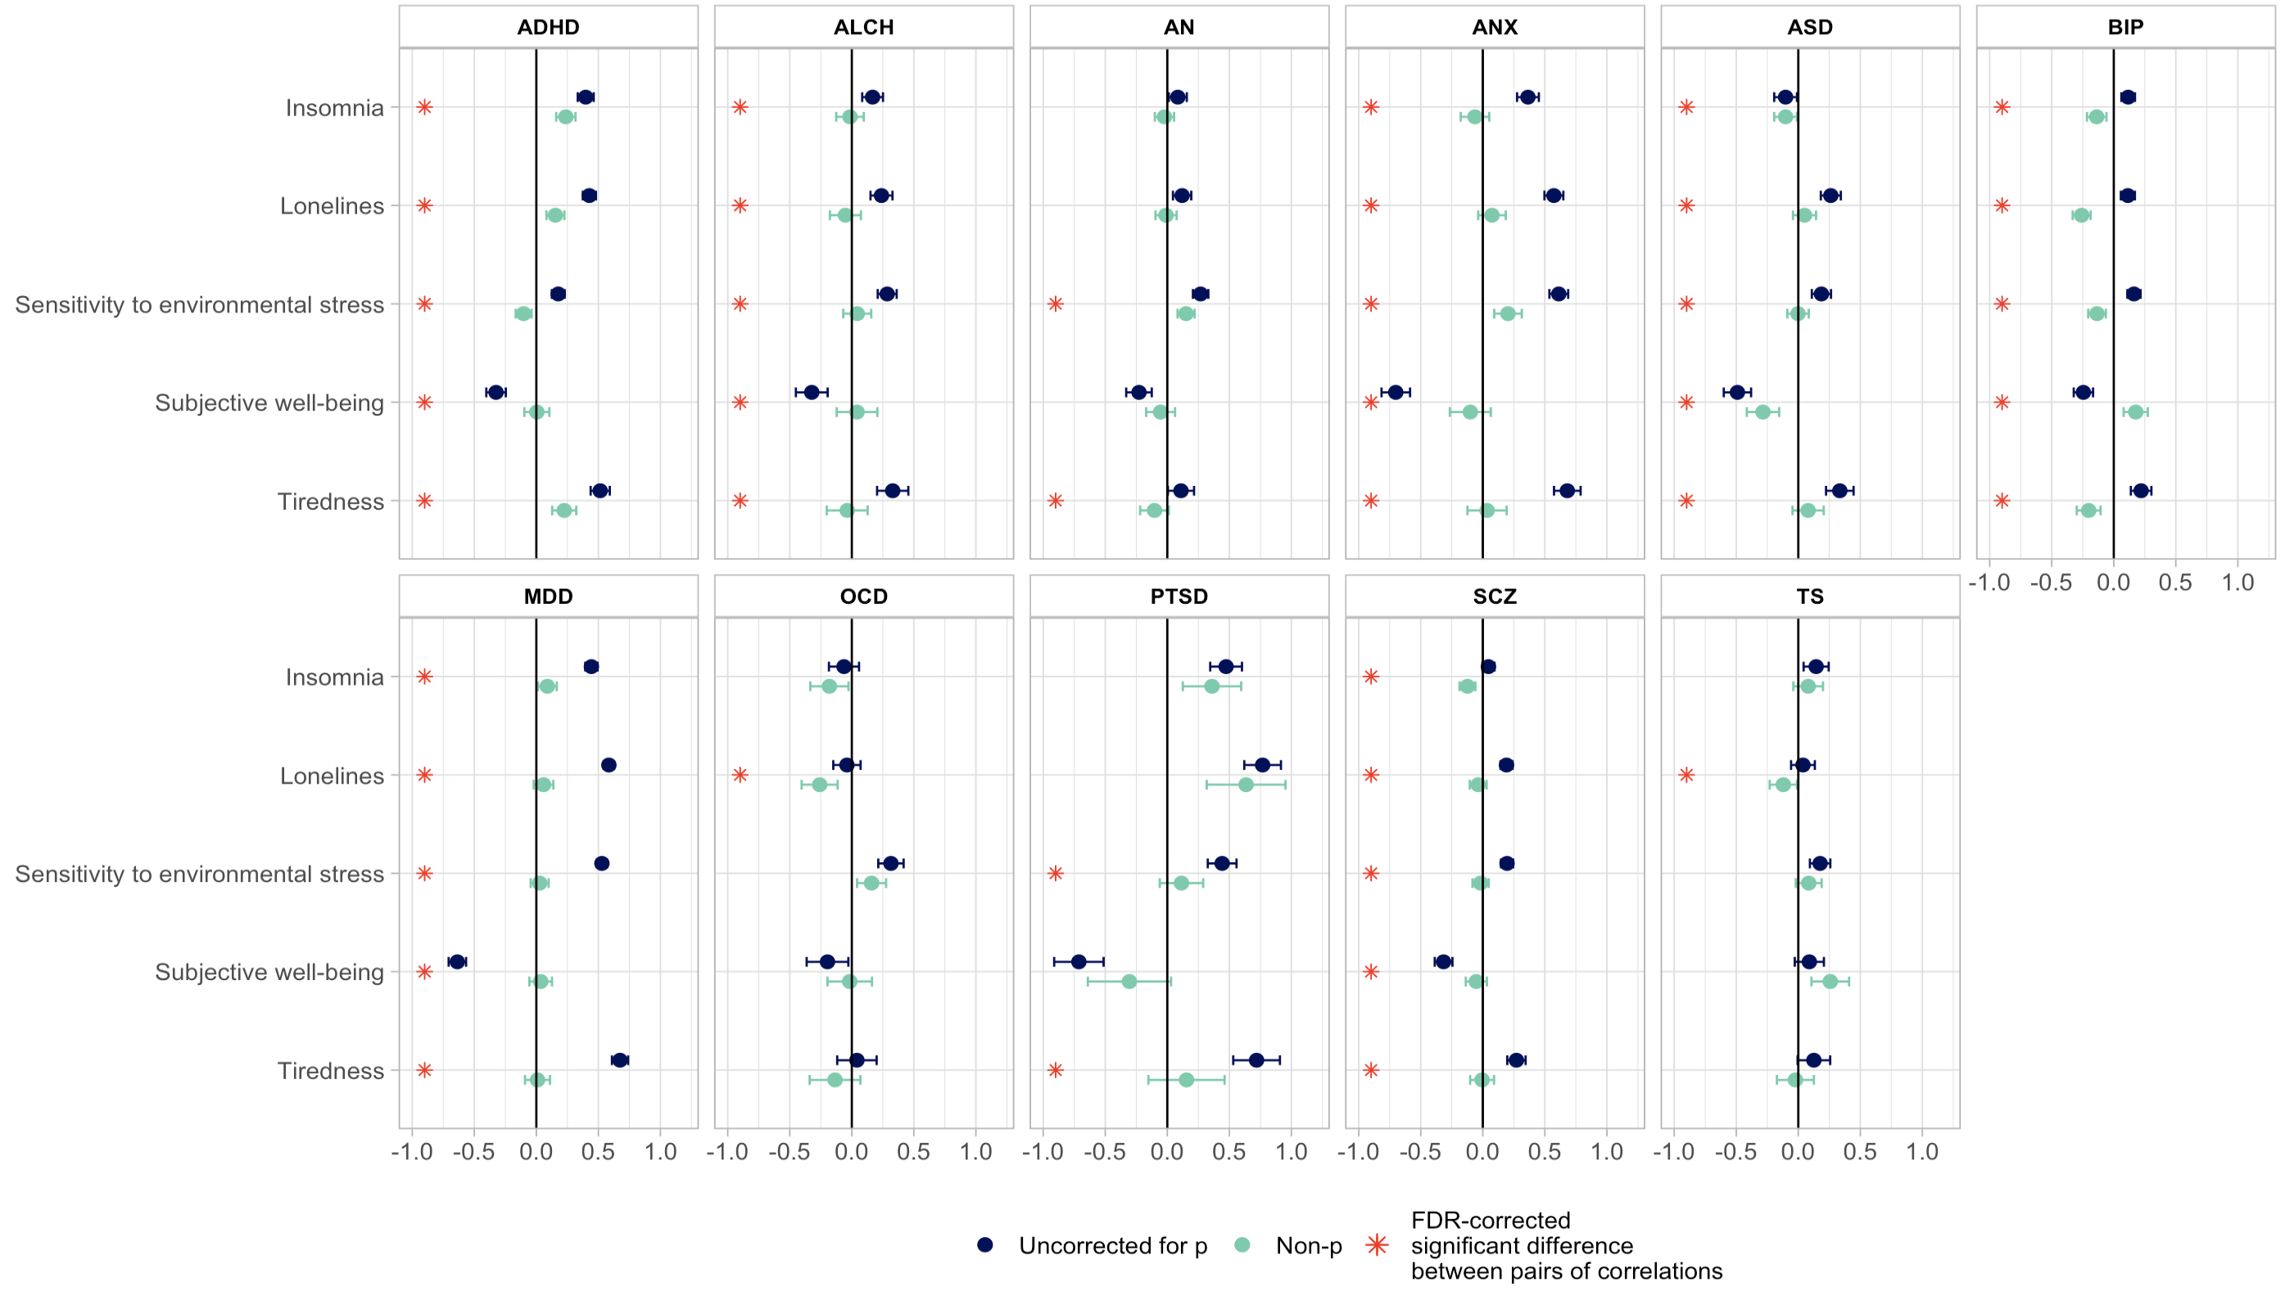
Removing transdiagnostic genetic effects from psychiatric disorders resulted in divergent patterns of genetic associations with biobehavioural traits.
ANX (0.61 > 0.20)
MDD (0.53 > 0.03)
ALCH (0.29 > 0.04)
AN (0.26 > 0.15)
SCZ (0.20 > -0.01)
ASD (0.19 > -0.01)
Notes:
For example, consider sensitivity to environmental stress. So, uncorrected for p, genetic correlations between sensitivity to environmental stress and most of the disorders were positive and sometimes substantial. However, for non-p disorders, these correlations were significantly lower, almost 0.
So, it seems that, p explains the initial genetic overlap between sensitivity to environmental stress and these disorders. And we took out p, there wasn’t any overlap.

Slide 27
Removing transdiagnostic genetic effects from psychiatric disorders resulted in divergent patterns of genetic associations with biobehavioural traits.
Notes:
There was also similar pattern of results for some other traits that often co-occur with most psychiatric disorders, such as loneliness, tiredness and insomnia.
So, it’s like p is explaining the genetic relationship between these traits and the disorders.

Slide 28
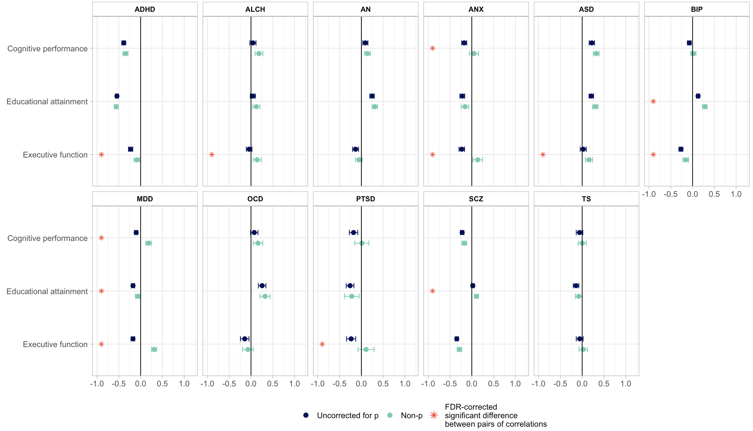
Removing transdiagnostic genetic effects from psychiatric disorders resulted in divergent patterns of genetic associations with biobehavioural traits.
Educational attainment & BIP (0.13 > 0.28)
Educational attainment & SCZ (0.02 > 0.11)
Notes:
Although most of the changes in correlations were reductions, there were some other patterns of changes.
Here is an interesting one.. educational attainment…
There was a low, positive genetic correlation between educational attainment and both BIP and SCZ. However, after taking out genetic effects with p, the genetic correlations between them increased significantly.

Slide 29
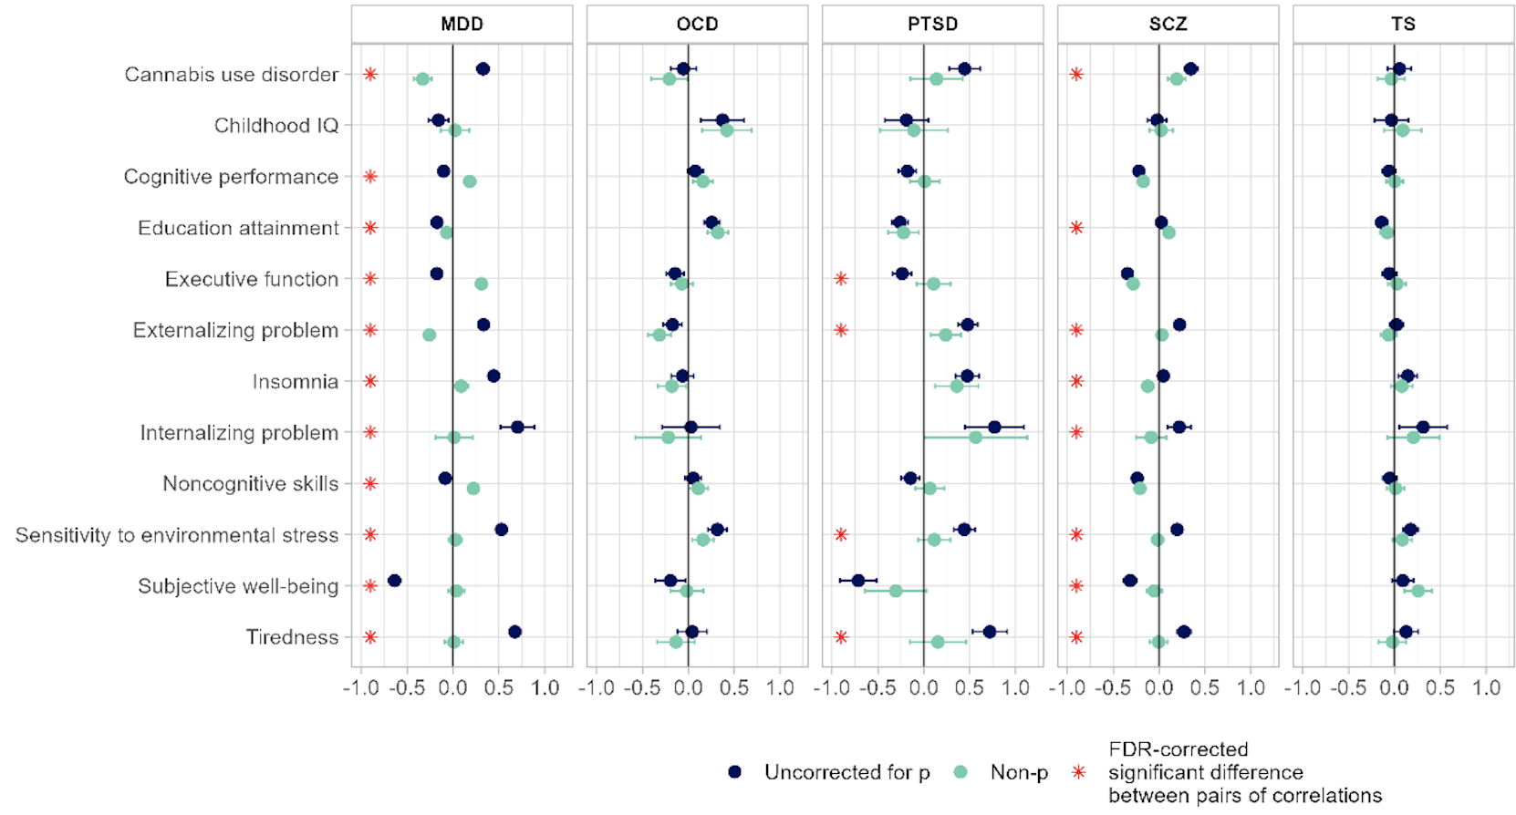
Removing transdiagnostic genetic effects from psychiatric disorders resulted in divergent patterns of genetic associations with biobehavioural traits.
MDD
Cognitive performance (-0.10 > 0.18)
Executive functioning (-0.18 > 0.31)
Noncognitive skills (-0.09 > 0.22)
Notes:
And lastly, other genetic correlations reversed after accounting for p. For example, the genetic correlation between MDD and several cognitive-related traits such as cognitive performance, executive functioning and noncognitive skills…these original negative correlations changed to positive after accounting for p.
So, perhaps this general liability to psychopathology, as captured by p here, is more related to cognitive impairments in the context of MDD.

Slide 30
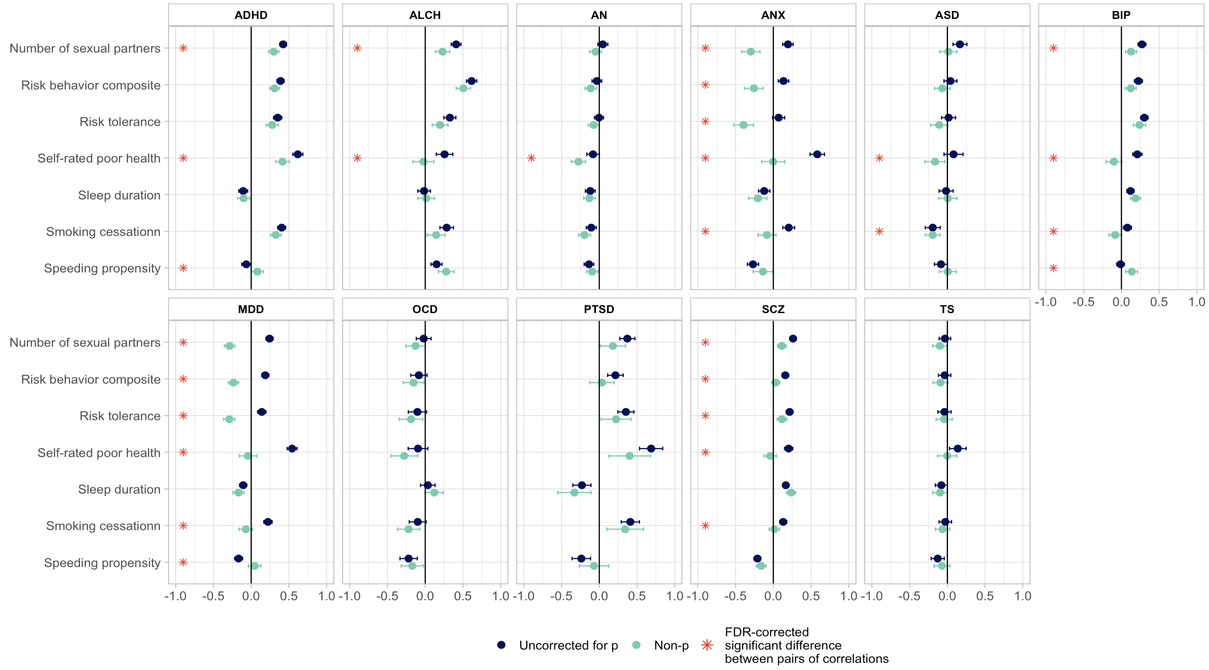
Removing transdiagnostic genetic effects from psychiatric disorders resulted in divergent patterns of genetic associations with biobehavioural traits.
ANX
Risk-taking
(0.14 > -0.26)
Risk tolerance (0.07 > -0.39)
No of sexual partners (0.22 > -0.29)
MDD
Risk-taking
(0.19 > -0.23)
Risk tolerance (0.14 > -0.29)
No of sexual partners (0.24 > -0.28)
Notes:
Here is another interesting one.. correlations between ANX and MDD and risk-related behaviour such as risk taking, risk tolerance and no of sexual partners changed from positive to negative
So, it seems that once we took out p, MDD and ANX was associated with increased risk avoidance rather risk-seeking.

Slide 31
Next steps
Notes:
I am currently working on a project where we use PGS created from these non-p summary statistics to predict psychopathology symptoms and I am now going to present you some preliminary findings from this project.
AND my colleague and the joint first author in this project, Wangjingyi Liao, is working on a project where she used these non-p PGS to investigate the xxxx…she is presenting a poster of her findings at the poster session today (time)

Slide 32

Next steps
Using polygenic scores -uncorrected and corrected for p
To examine specificity in predicting psychopathology
To investigate the association between risk for psychopathology
and cognition over development
Wangjingyi Liao
Notes:
I am currently working on a project where we use PGS created from these non-p summary statistics to predict psychopathology symptoms and I am now going to present you some preliminary findings from this project.
AND my colleague and the joint first author in this project, Wangjingyi Liao, is working on a project where she used these non-p PGS to investigate the xxxx…she is presenting a poster of her findings at the poster session today (time)

Slide 33
Conclusion
GWAS of disorder-specific genetic risk that is independent of p
Reveals a different genetic architecture of psychiatric disorders
Genetic correlations with external traits show greater specificity
Notes:
So, in summary, we used genomic SEM to create these more specific summary statistics for 11 major psychiatric disorders, that are independent of p.
2) And it’s been powerful because removing this shared genetic variance significantly changed the patterns of genetic relationships between psychiatric disorders.. and it’s not just lowering all genetic correlations. It showed us a different genetic landscape of psychopathology.
3) And the changes in genetic correlations with external traits also showed greater specificity.
We also run further analyses, for example we identified independent significant hits for the non-p factors, and conducted functional annotation…it’s all in the pre-print of our paper.
So our result overall highlight the importance of considering both generality and specificity in psychiatric genetics. So, depending on the specific purpose of a genetic study, researchers can consider partialling out p-related genetic variance. This will of course remove some of the genetic variance, but whatever is remaining, will be more trait-specific, and possibly more relevant from a research and clinical perspective.

Slide 34





Thank you
Supervisors:
Prof Robert Plomin
Dr Kaili Rimfeld
Dr Margherita Malanchini
Collaborators:
Wangjingyi Liao
Dr Andrea Allegrini
Prof Thalia C. Eley
Notes:
I’d like to thank to my supervisors and the collaborators in this project.

